Slide 1
Teamwork
7.0
Notes:
Replace this with your course title and your name/contact details.

Slide 2
Overview
Teamwork
Version control

Slide 3
The need to work in teams
Programming sometimes requires deep individual intellectual work.
But this is only a small part of the process of writing software.
Working as part of a team is the norm.
Programming, at a professional level, is a people-centered, social activity.

Slide 4
Pair programming
A way of two people working together on a single piece of software.
Part of the extreme programming methodology, developed by Kent Beck.
Two people work together, but they use only one machine.

Slide 5
Pair programming
One person is the driver, the other is the navigator.
The driver has the keyboard and does the typing.
The navigator looks at the same screen, thinks and plans and analyses.
Both are in conversation about the next steps, what to write, how to proceed.
The two swap places regularly.
Both work jointly on the same problem.

Slide 6
Pair programming
This way of working leads to better quality code than would be developed by a single programmer.
The narrative process reduces misconceptions.
Errors are spotted more quickly during initial coding.
Debugging and bug fix times are reduced.

Slide 7
Teamwork: the problem
How can I develop and test my code when another programmer may need to make changes to the same file?
What if I need to test, but another programmer is in the middle of some work, and the system cannot be compiled?
What if we need to change the same class, and we interfere with each other's edits?

Slide 8
Ad-hoc solutions don't work
Working on separate copies and editing independently often leads to incompatibilities.
Working on a single, shared copy means there is a risk of work being overwritten, and incomplete changes holding up development and testing.

Slide 9
Shared space with local copies
Combines the two previous ideas.
Can be made to work but requires supporting technology: a version-control system (VCS).

Slide 10
Terminology
repository: the central space that holds the shared project, accessible by all developers.
primary version: the copy of the project in the shared repository.
working copies: independent copies of the project in each developer's local file space.

Slide 11
Terminology
checkout: make a local copy of the primary version.
commit: copy working copy changes into the primary version.
update: copy recent changes from the primary version to a working version.

Slide 12
Terminology
merge: integrate changes from a working copy to the primary version. This is more complex than simply replacing one file with another.
conflict: multiple changes to the same file that are incompatible. The conflict must be resolved in some way.

Slide 13
Software development: solo

Slide 14
Software development: team

Slide 15
Updates and Commits

Slide 16
Conflicts
When you attempt to commit, the primary copy of the file might already have further changes since your last update.
If there is no conflict with those then the VCS will merge in your further changes.
If there is a conflict, the VCS will not update the primary copy.
update before commit to identify conflicts
Resolve conflicts and then commit.

Slide 17
Software development: team

Slide 18
Teamwork in BlueJ
BlueJ has support for GIT.
GIT uses two levels of repositories: a local repository and a remote repository.
The local repository resides on your own machine.
The remote repository is on the shared server and holds the primary copy.

Slide 19
The GIT model
commit (frequently) the working copy to the local repository.
push significant changes from the local repository to the remote repository.
pull from remote to local, which includes a merge operation on the working copy.

Slide 20
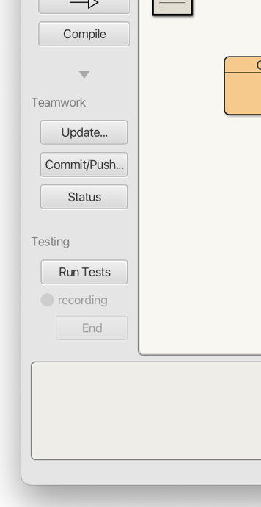
BlueJ's Teamwork controls

Slide 21
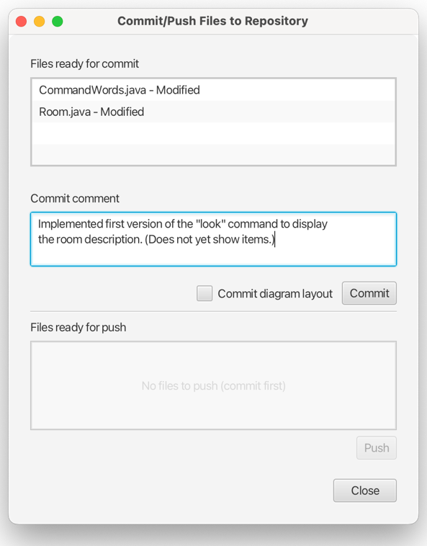
BlueJ's Commit/Push dialog

Slide 22
Review
Teamworking is the norm in software development projects.
Pair programming is a good first step to collaborative programming.
Teamwork needs technical support to be effective.

Slide 23
Review
Version control systems support a central primary repository and separate, local working copies.
They support conflict detection and resolution.
BlueJ supports the GIT VCS.

